Slide 1

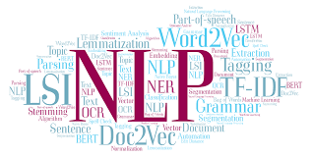
CSCE 5290
Natural Language Processing
Introduction to NLP Course Instructor: Zeenat Tariq
Notes:
This is Zeenat Tariq, your instructor for this course. I am pleased to have you enrolled in my natural language processing course, and I hope you learn from all lectures.

Slide 2

This class
Teaches key theory and methods for statistical NLP:
Viterbi
Naïve Bayes, Maxent classifiers
N-­‐gram language modeling
Statistical Parsing
Inverted index, tf-­‐idf, vector models of meaning
For practical, robust real-­‐world applications
Information extraction
Spelling correction
Information retrieval
Sentiment analysis
Notes:
The main objective of this course is to teach fundamental theories and techniques for statistical natural language processing. We will discuss Maxent classifiers, Naive Bayes, and the Viterbi algorithm. We'll cover statistical parsing and n-gram language modeling. We will discuss vector models of meaning, tf-idf, and the inverted index, which are crucial to information retrieval. Also, we'll use this for solid, real-world applications. We'll discuss information retrieval, spelling correction, and information extraction.

Slide 3

Skills you’ll need
Simple linear algebra (vectors, matrices)
Basic probability theory
Python programming
Weekly programming Tutorials
Assignments
Notes:
You will need basic linear algebraic skills for this task, so you should be familiar with vectors and matrices. You should be familiar with some basic probability theory, and since there will be programming tutorials and assignments, you must be familiar with Python.

Slide 4
What is Natural language processing? It is an interdisciplinary subfield of computer science and linguistics.
Natural Language Understanding
Natural Language Generation
It is primarily concerned with giving computers the ability to support and manipulate human language. Applications of NLP: 1.Chatbot 2.Machine Translation 3.Sentiment analysis and many more…..
Notes:
What is meant by natural language processing? You're listening to the words and sentences that I'm forming right now, and you're developing some kind of comprehension as a result. And natural language processing, or NLP, is what happens when we ask a computer to perform that task.
In this case, natural language processing (NLP) bridges the gap between unstructured and structured data. And this process of moving from this unstructured state to this structured one is known as natural language understanding, or NLU. Additionally, this process of transitioning from structured to unstructured data is known as natural language generation, or NLG.
We now need to comprehend the sentence's context when translating from one language to another. Translation involves more than just taking a word, say, from English and translating it into another language. What is being said needs to be understood in its overall context and structure.

Slide 5
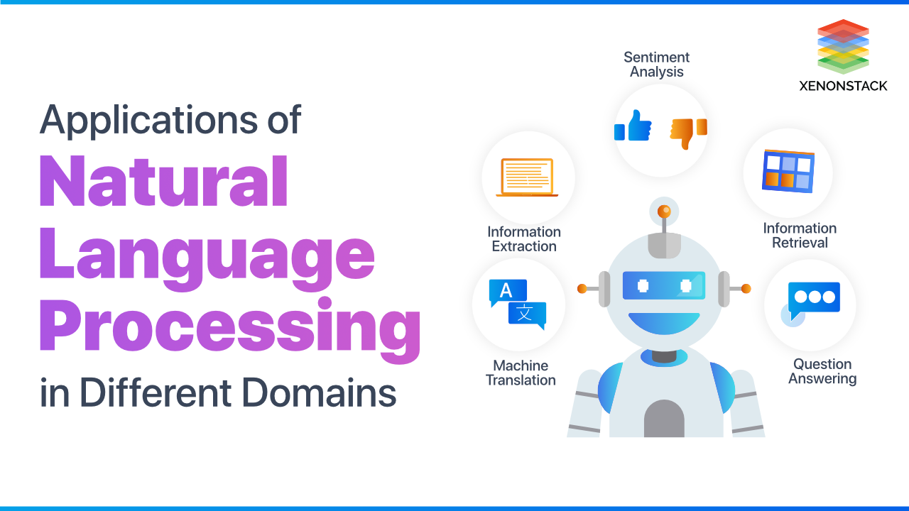

Let us look at some applications in detail
Notes:
The huge amount of data available on social media and the web has enabled the creation of amazing new applications. Let's examine some of the applications.

Slide 6
Question Answering: IBM’s Watson
Won Jeopardy on February 16, 2011!
WILLIAM WILKINSON’S
“AN ACCOUNT OF THE PRINCIPALITIES OF WALLACHIA AND MOLDOVIA”
INSPIRED THIS AUTHOR’S MOST FAMOUS NOVEL
Bram Stoker
Notes:
Question answering is one of those applications. As you may be aware, on February 16th, IBM's Watson won the Jeopardy challenge. In 2011, responding to inquiries such as "This author's most famous novel was inspired by William Wilkinson's book" You may already be aware that the author of Dracula, Bram Stoker, is the answer.

Slide 7
Information Extraction
Information extraction is the task of automatically extracting structured information from unstructured and/or semi-structured machine-readable documents and other electronically represented sources.
Event: Curriculum mtg
Date: Jan-16-2012
Start: 10:00am
End: 11:30am
Where: Gates 159
Subject: curriculum meeting
Date: January 15, 2012
To: Dan Jurafsky
Hi Dan, we’ve now scheduled the curriculum meeting.
It will be in
-­‐Chris
Gates 159 tomorrow from 10:00-­‐11:30.
Create new Calendar entry
Notes:
The extraction of information is a further essential task. Let's take an example about an email regarding setting up a meeting. Software or a calendar should be able to automatically identify events such as tomorrow, times between 10 and 11:30, and rooms like Gates 159. It should then be able to extract that information, create a new calendar entry, and then fill in the calendar with this type of structured data for a calendar program. Additionally, most current calendar and email apps can accomplish this from text.

Slide 8

Information Extraction & Sentiment Analysis
zoom aﬀordability size and weight ﬂash
ease of use
Size and weight
✓
✓
nice and compact to carry!
since the camera is small and light, I won't need to carry around those heavy, bulky professional cameras either!
the camera feels ﬂimsy, is plastic and very light in weight you have to be very delicate in the handling of this camera
✗
Notes:
Let's say you like to check out online reviews of cameras. The objective is to automatically determine what features, such as zoom, price, or size, people find important in cameras. We want the system to automatically recognize these attributes. We also try to ascertain the opinion that reviews have for each attribute. A review mentioning "nice and compact," for example, would be positive; however, a term like "flimsy" would indicate a negative opinion. The aim is to automatically identify the sentiment present in every sentence and combine it with other features, such as affordability or zoom.

Slide 9
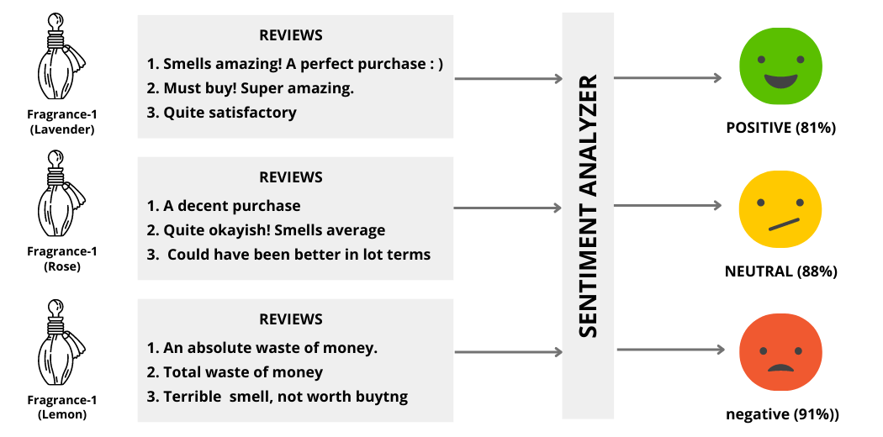
What do you mean by sentiment analysis?
Sentiment analysis is the process of analyzing digital text to determine if the emotional tone of the message is positive, negative, or neutral

Slide 10
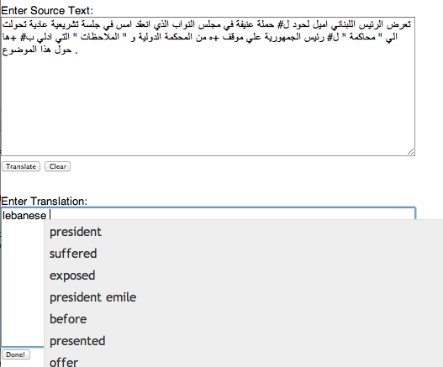


Machine Translation
Machine translation is the process of using artificial intelligence to automatically translate text from one language to another without human involvement.
Helping human translators
Fully automatic
Enter Source Text:
这 不过 是 一 个 时间 的 问题 .
Translation to English:
This is only a matter of time.
Notes:
Another significant new application is machine translation, which has the capability to be entirely automated. For instance, the Machine Translation system can translate a Chinese source sentence into English. This text may be Arabic, but machine translation (MT) can also be used to support human translators. Additionally, the machine translation (MT) system may provide assistance to the human translator in translating it into English. For instance, the MT system may automatically generate a list of potential next words to aid the human translator. Let's examine language technology as it stands today.

Slide 11
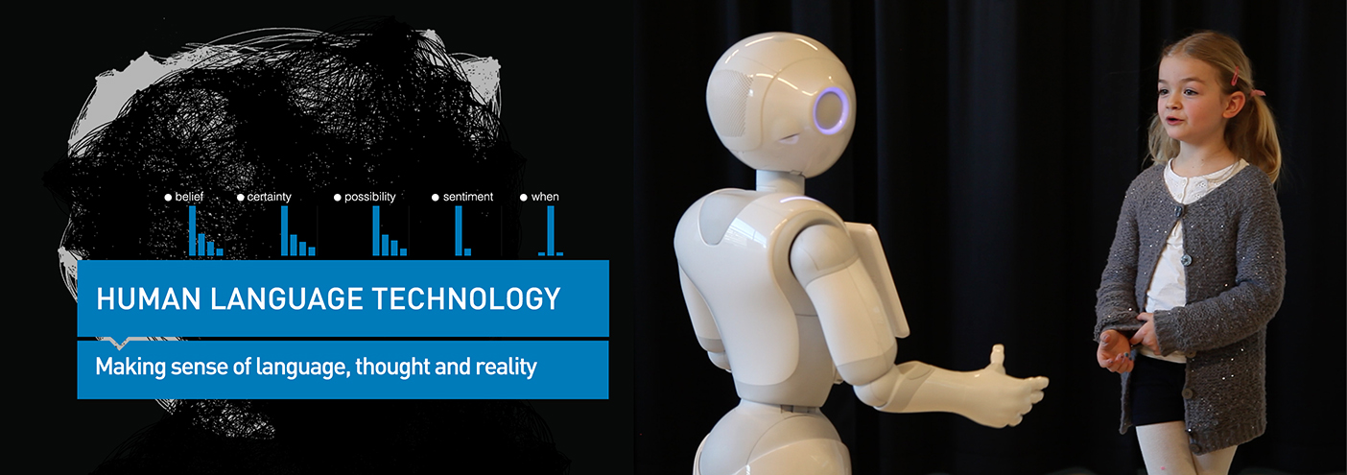
Language Technology
Language technology, often called human language technology, studies methods of how computer programs or electronic devices can analyze, produce, modify or respond to human texts and speech.
Notes:
Let’s see the language technology which is often called human language technology, studies methods of how computer programs or electronic devices can analyze, produce, modify or respond to human texts and speech.

Slide 12
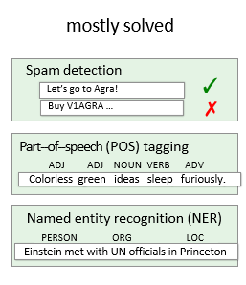
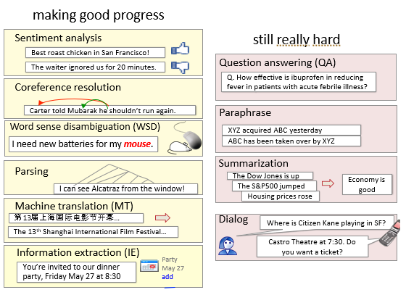
Language Technology
Notes:
NLP is organized into specialties and subspecialties, just like any other field. Many of these issues are practically resolved. For instance, while 99% of the emails we receive contain spam, it can be difficult to identify all of the spam. This is because spam detection is a relatively simple classification task. Named entity tagging and part of speech tagging are two crucial component tasks. Later in the course, we'll discuss those in more detail. They operate at fairly high accuracy levels; we'll achieve 97% accuracy on part of speech tagging and see how crucial that is for parsing. We are making good progress on other tasks.

Slide 13
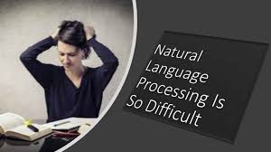
Notes:
Why is natural language processing so difficult?

Slide 14



Ambiguity makes NLP hard: “Crash blossoms”
Violinist Linked to JAL Crash Blossoms Teacher Strikes Idle Kids
Red Tape Holds Up New Bridges Hospitals Are Sued by 7 Foot Doctors Juvenile Court to Try Shooting Defendant Local High School Dropouts Cut in Half
Notes:
An amazing example of this would be the ambiguity problems known as crash blossoms. Therefore, ambiguity is any situation in which there are possible interpretations for a surface form. An example of a headline with two meanings that lend themselves to a humorous interpretation is called a crash blossom. When you read the first headline, "Violinist Linked to JAL Crash Blossoms," you might assume that the violinist is being linked to something, but what exactly is the main verb linked to? He is associated with the crash blossoms of Japan Airlines. Then tell me about crash blossoms. The fact that blossoms was the primary verb in the headline writer's intended interpretation gave rise to the name of this phenomenon. A violinist is the one who blossoms. And the violinist was a modifier of the fact that they were connected to the JAL crash.
Teacher Strikes Idle Kids has similar syntactic ambiguities. The primary verb in the sentence was meant to be idle; the strikes made the kids idle. Naturally, the ironic reading is that the instructor is on strike, the verb "strike" is used, and the students are being struck by the teacher.
Word sense ambiguity is another significant type of ambiguity. We will refer to the author's intended meaning of "holds up" in our third example, Red Tape Holds Up New Bridges, as meaning "delay." The second meaning of holds up, which we could record as supporting, is the humorous interpretation, though.
Likewise, there are numerous other types of ambiguities in the given headlines.

Slide 15
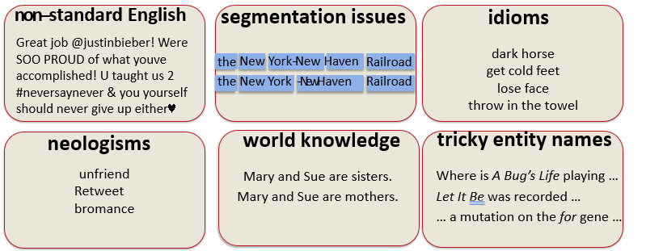
Why else is natural language understanding difficult?
But that’s what makes it fun!
Notes:
There are several additional factors that complicate natural language. One of them is the nonstandard English that we commonly have in text, such as Twitter feeds, where words, hashtags, user IDs, and other information are spelled differently and capitalized. Because of this, all of our parsers and some of the speech taggers that we will use are frequently trained on very clean newspaper text English, but we will have a lot of issues with real English in the real world. There will be numerous segmentation issues. For example, if we see the string Y-O-R-K dash N-E-W is part of New York-New Haven, how do we know the correct segmentation is New York and New Haven? Therefore, it is the New York-New Haven railroad and not York dash New. This word is not the same as the word in dash (-) law. The segmentation problem must be properly solved. We struggle with idioms and novel words that we never came across before. Also, entity names will cause issues for us, similar to the English words in the film A Bug's Life. And as a result, it’s also frequently challenging to determine when the film title begins and ends.

Slide 16
Making progress on this problem…
The task is difficult! What tools do we need?
Knowledge about language
Knowledge about the world
A way to combine knowledge sources
How we generally do this:
probabilistic models built from language data
P(“maison”  “house”) high
P(“L’avocat général”  “the general avocado”) low
Luckily, rough text features can often do half the job.
Notes:
Natural language understanding is an extremely challenging task. What resources/tools are necessary? We therefore require knowledge of the world, language, and how to integrate these knowledge bases. Therefore, using probabilistic models built from linguistic data is typically how we go about doing this. Thus, for instance, we are very likely to translate the French word maison as "house" in English. However, we are extremely unlikely to interpret the French term L'avocat general as the general avocado. Moreover, it can be quite challenging to train these probabilistic models generally. However, it turns out that with rough text features, we can create approximate probabilistic models, which we will introduce along the way.

Slide 17


